Slide 1
JShelf Group Sharing

Slide 2
Plan
18 Nov: How to write AngularJS in modulized way? Boilerplate for structure should be defined.
02 Dec: What we use to manage front-end lib: Bower, NPM, Webpack, JSPM? How to share code with Node.js
16 Dec: Use TypeScript or Write ES6 code directly?
30 Dec: How to implement LiveReload / Hot Swapping for AngularJS / Node.js code
13 Jan: Work out tool chain & guideline for development activities. (Unit Test, Lint, etc)
27 Jan: Docker

Slide 3
Agenda
Modularization
Structure

Slide 4
Modularization
Why Module?
解决命名冲突
解决文件依赖
方便打包管理
…

Slide 5
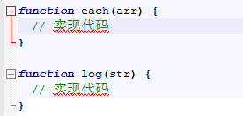
Modularization
远古时期

Slide 6
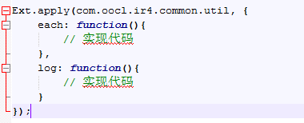
Modularization
Package/Namespace

Slide 7
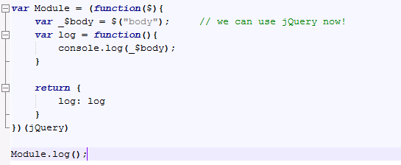
Modularization
闭包

Slide 8

Modularization
CommonJS/Modules 1.0
同步加载，不适合浏览器

Slide 9
Modularization
AMD(Async Module Definition)
RequireJS 对模块定义的规范化产出
CMD(Common Module Definition)
SeaJS 对模块定义的规范化产出

Slide 10

Modularization
AMD
预先加载，预先执行

Slide 11
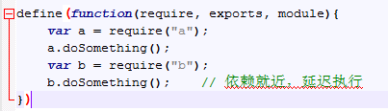
Modularization
CMD
预先加载，Lazy执行

Slide 12
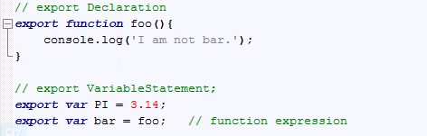
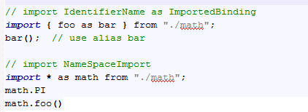
Modularization
ES6

Slide 13
Agenda
Modularization
Structure

Slide 14
Structure
思路
代码分Server，Client
代码按照Module/Feature划分
用NPM取代Bower管理前端JS库
少config，通过code里依赖打包(Browserify | Webpack)
使用Gulp构建前端项目

Slide 15
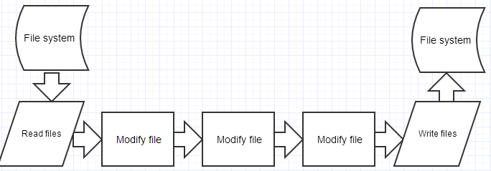
Structure
关于Gulp
基于流的前端架构工具，提供task定制API

Slide 16
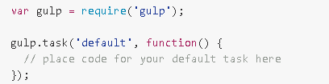
Structure
关于Gulp
Install
$ npm install --global gulp
Create gulpfile.js
Run
$ gulp

Slide 17
Structure
关于Gulp
gulp.task(name, fn)
gulp.run(tasks...)
gulp.watch(glob, fn)
gulp.src(glob)
gulp.dest(folder)

Slide 18
Demo Project
├─dist ---- build 出来的目标文件夹,相当于 maven build出来的target文件夹
│ ├─build
│ ├─release
│ └─tmp
├─gulp ---- gulp 构建任务
│ └─tasks
└─src ---- source folder
├─client ---- 前端代码
│ ├─auth
│ │ ├─controllers
│ │ ├─routes
│ │ └─views
│ └─home
│ ├─controllers
│ ├─routes
│ ├─styles
│ └─views
└─server ----服务器端代码
└─home
├─controllers
└─routes

Slide 19
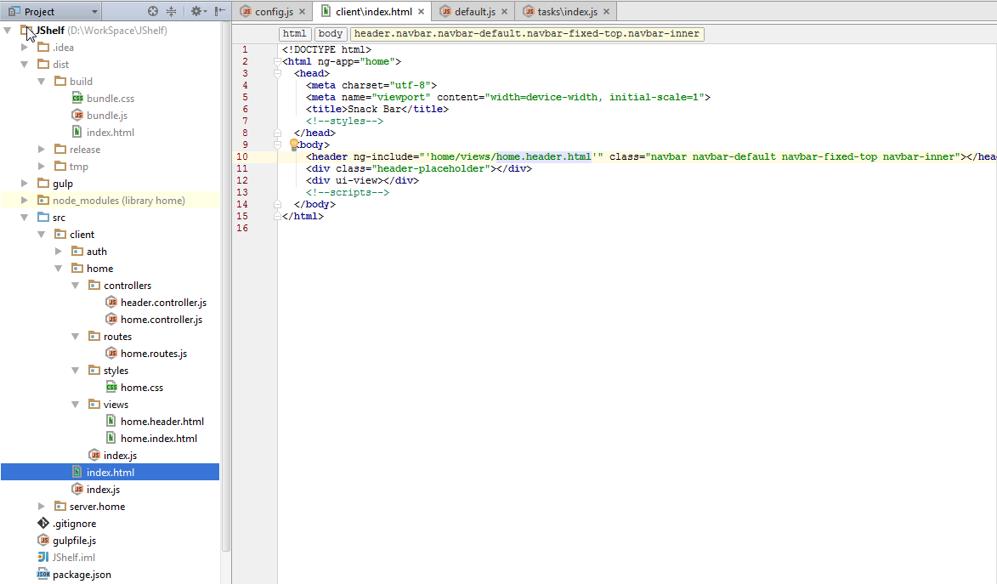
Gulp Task: index

Slide 20
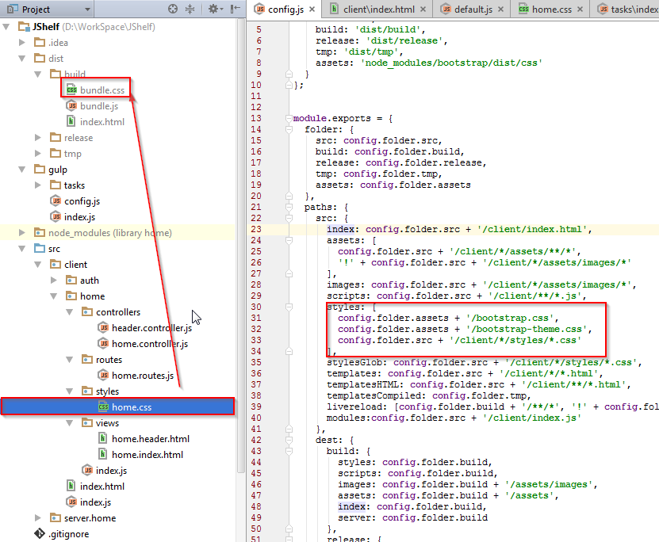
Gulp Task: index

Slide 21
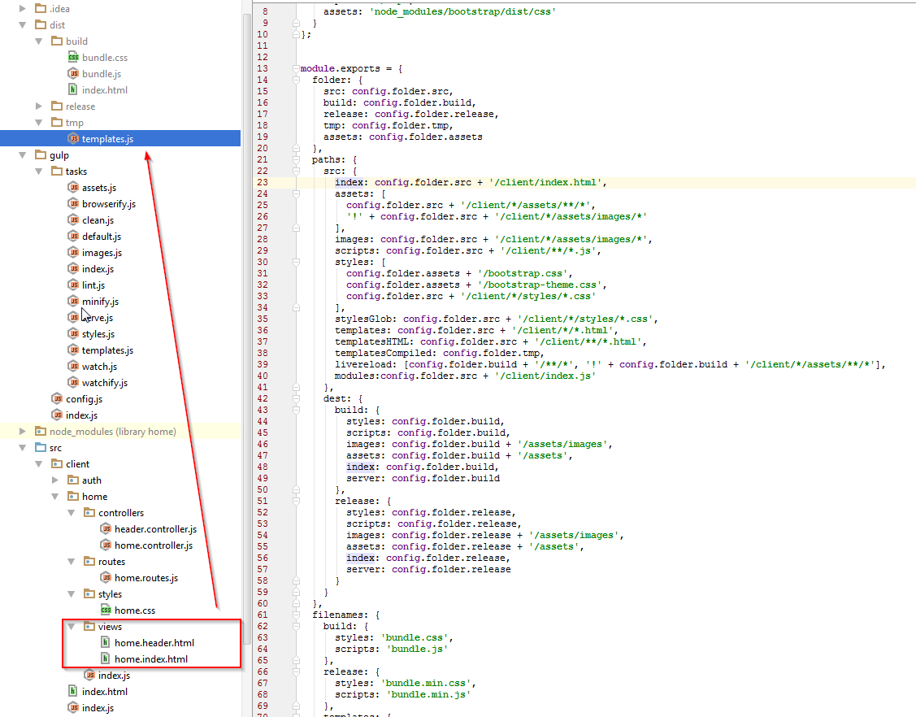
Gulp Task: Template

Slide 22
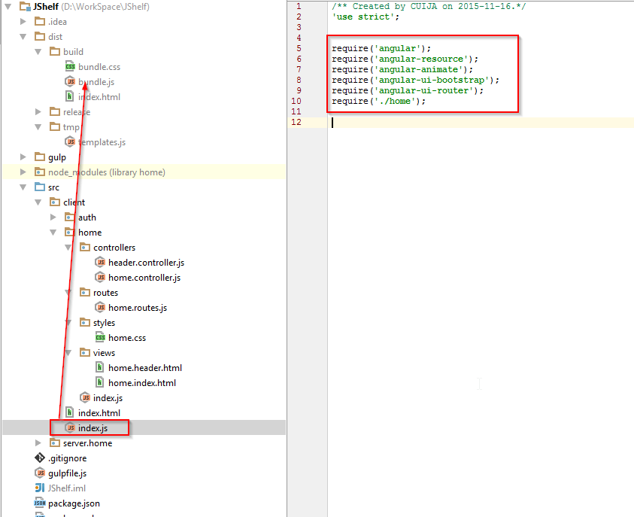
Gulp Task: Browserify

Slide 23

Structure
Discussion

Slide 24
Reference
https://github.com/Dantemo/JShelf.git

Slide 25
Thank You!

